Slide 1
Objects and Classes
Control Flow in Java
Object Interaction

Slide 2
Objects and Classes
  The foundation of Object Oriented Programming

Slide 3
Fundamental Concepts
object
class
method
parameter
data type
Notes:
You don’t always need to show all these slides in class.
These are intended as summaries. Discuss these topics
with a demo, or in a dialog, or in any way you like.

Slide 4
Objects and Classes
Objects
  represent ‘things’ from the real world, or from some problem domain (example: “the red car down there in the car park”)‏
Classes
  represent all objects of a kind (example: “car”)‏
Objects represent individual instantiations of the class. Object are instantiated.

Slide 5
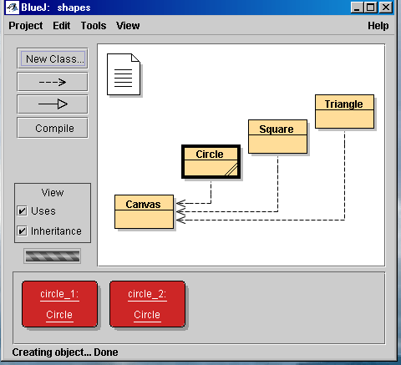
Objects and Classes in BlueJ

Slide 6
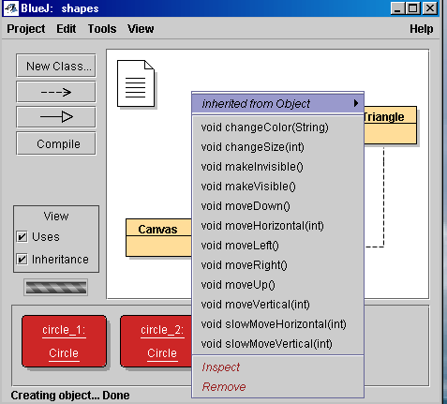
Things we can do with Objects

Slide 7
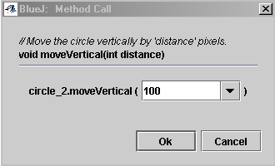
Things we can do with Objects

Slide 8
Methods and Parameters
Objects/classes have operations which can be invoked. They are called methods
void moveHorizontal(int distance) is called the signature of the methods
The collection of methods of a class is referred to as the interface of that class
methods may have parameters to pass additional information needed to execute
Methods are called or invoked

Slide 9
Data Types
Parameters have types. A type defines what kinds of values a parameter can take.
Defining a class defines a type
In Java, everything has a type.
Java is strongly typed language
Examples of types: int, String, Circle, …

Slide 10
Other Observations
many instances can be created from a single class
an object has attributes: values stored in fields.
the class defines what fields an object has, but each object stores its own set of values.
These set of values is called the state of the object.

Slide 11
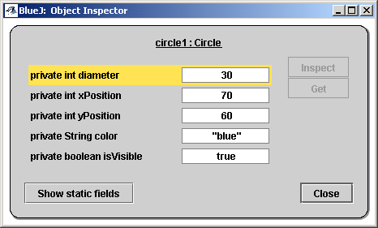
State

Slide 12
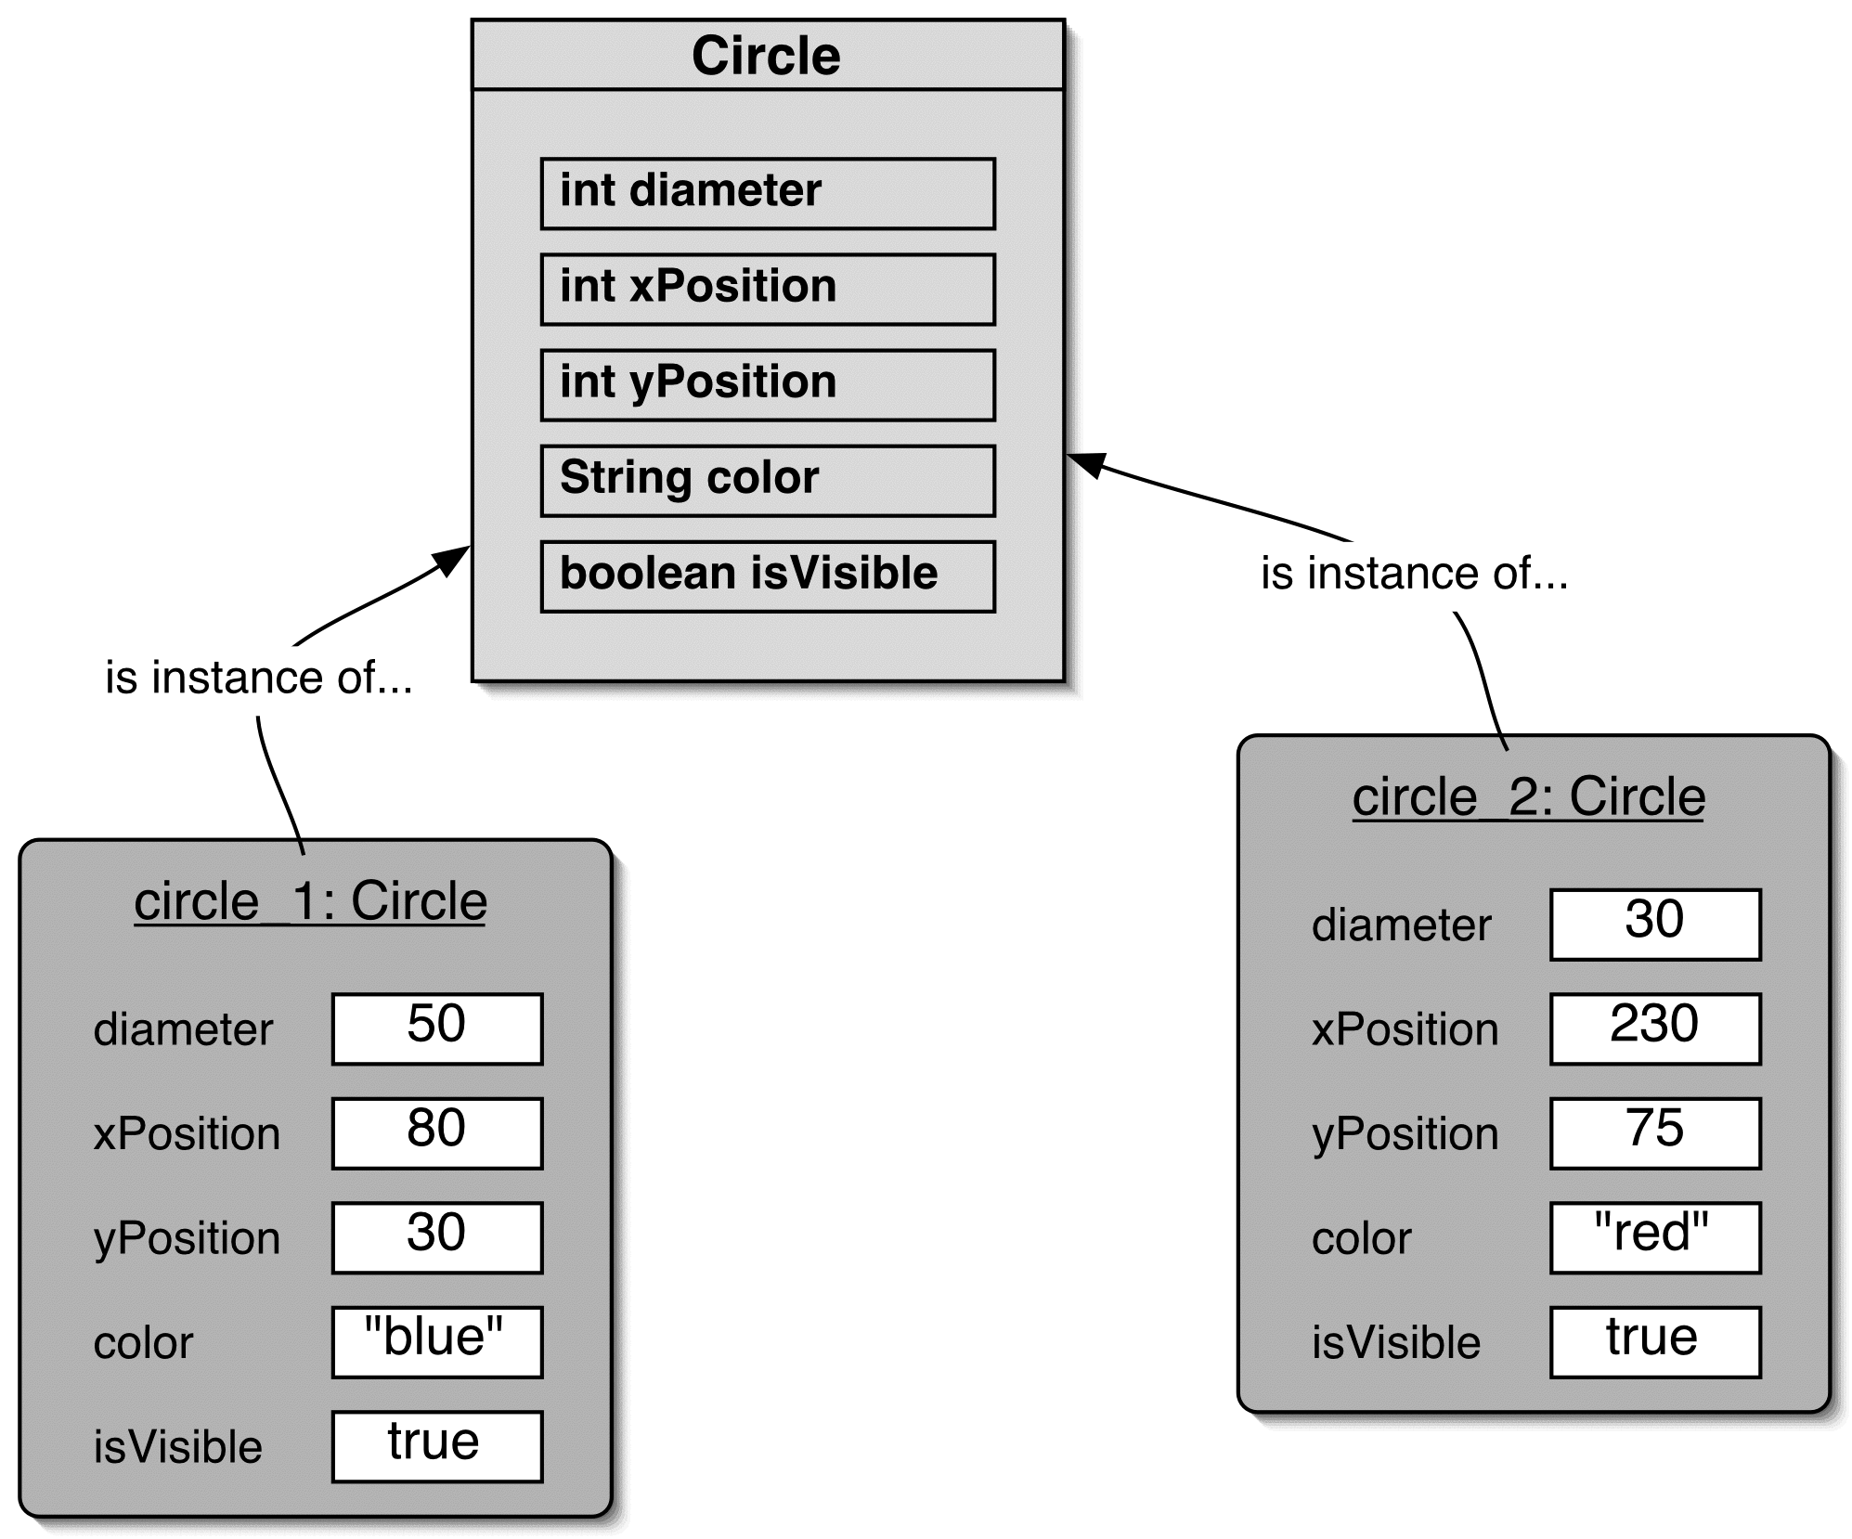
Two Circle Objects

Slide 13
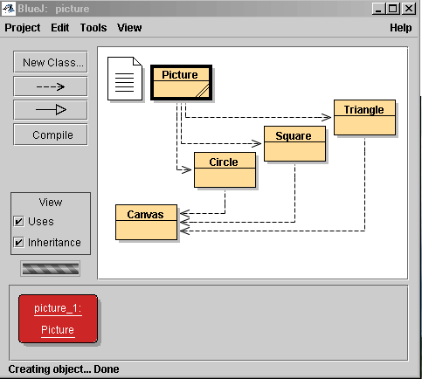
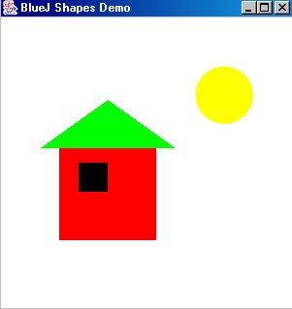
Object Interaction

Slide 14
Source Code
Each class has source code (Java code) associated with it that defines its details (fields and methods).
In other words, it determines the structure and the behavior of each of its instance.
This source code is compiled and interpreted by Java.

Slide 15
Return Values
Methods may return a result via a return value.
Example: String getName()‏
  This method returns a String.
Example: void changeName()‏
  Void indicates that this method does not return anything

Slide 16
Developing Java Programs
To learn to develop Java programs, one needs to learn how to write class definitions, including fields and methods, and how to put these classes together as well
During the rest of this unit we will deal with these issues in more detail

Slide 17
Coding Conventions
Classes: Uppercase to start, merge words, consecutive words uppercase, nouns
  E.g. Car, Number, BankAccount
Objects: Lowercase to start, merge words, consecutive words uppercase, nouns
  E.g. myBlueCar, Rational
Methods: Lowercase to start, merge words, consecutive words uppercase, verbs
  E.g. moveLocation, deposit

Slide 18
Terms
Object
Instance
State
Compiler
Virtual Machine
Method Calling
Class
Method
Return Value
Signature
Parameter
Type
Source Code

Slide 19
Understanding class definitions
  Looking inside classes

Slide 20
Main concepts to be covered
fields
constructors
methods
parameters
assignment statements
conditional statements

Slide 21
Ticket machines – an external view
Exploring the behaviour of a typical ticket machine.
  Use the naive-ticket-machine project.
  Machines supply tickets of a fixed price.
    How is that price determined?
  How is ‘money’ entered into a machine?
  How does a machine keep track of the money that is entered?
  How is a ticket provided?

Slide 22
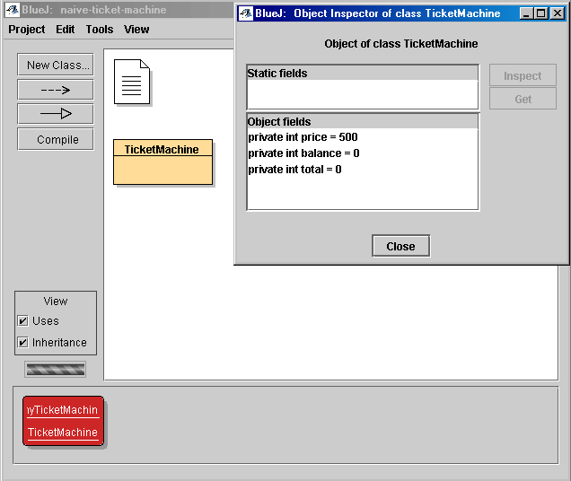
Resulting Fields

Slide 23
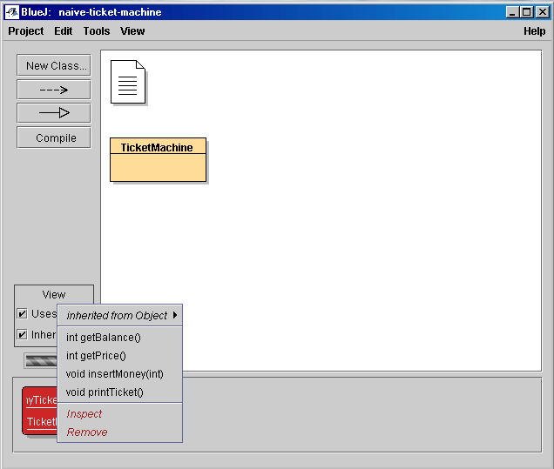
Resulting Methods

Slide 24
Ticket machines – an internal view
Interacting with an object gives us clues about its behavior.
Looking inside allows us to determine how that behavior is provided or implemented.
  Looking at the source code
All Java classes have a similar-looking internal view.

Slide 25
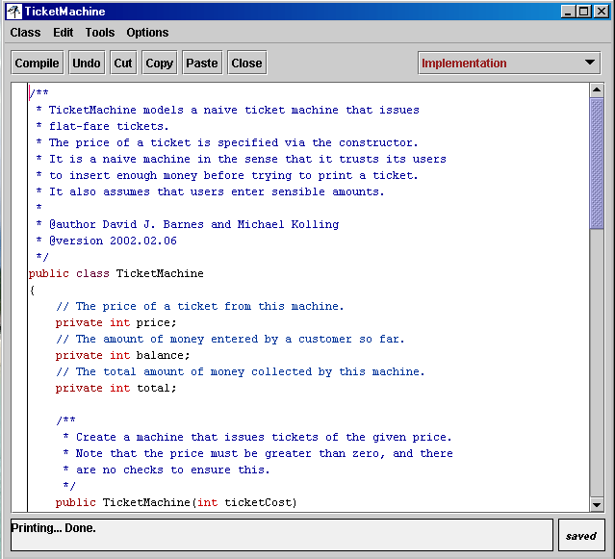
The Source Code

Slide 26
Basic class structure
The outer wrapper
of TicketMachine
public class TicketMachine
{
Inner part of the class omitted.
}
public class ClassName
{
Fields
Constructors
Methods
}
The contents of a
class

Slide 27
Comments/Documentation
Comments make source code easier to read for humans. No effect on the functionality.
Three sorts:
  // comment: single-line comments
  /* comments */: multiple-lines – more detail
  /** */: similar to previous, but used when documentation software is used.

Slide 28
Fields
Fields store values for an object.
They are also known as instance variables.
Use the Inspect option to view an object’s fields.
Fields define the state of an object.
public class TicketMachine
{
private int price;
private int balance;
private int total;
Constructor and methods omitted.
}
visibility modifier
type
variable name
private int price;

Slide 29
Constructors
Constructors initialize an object.
Then assign the necessary memory to the created object
They have the same name as their class.
They store initial values into the fields.
They often receive external parameter values for this.
public TicketMachine(int ticketCost)‏
{
price = ticketCost;
balance = 0;
total = 0;
}

Slide 30
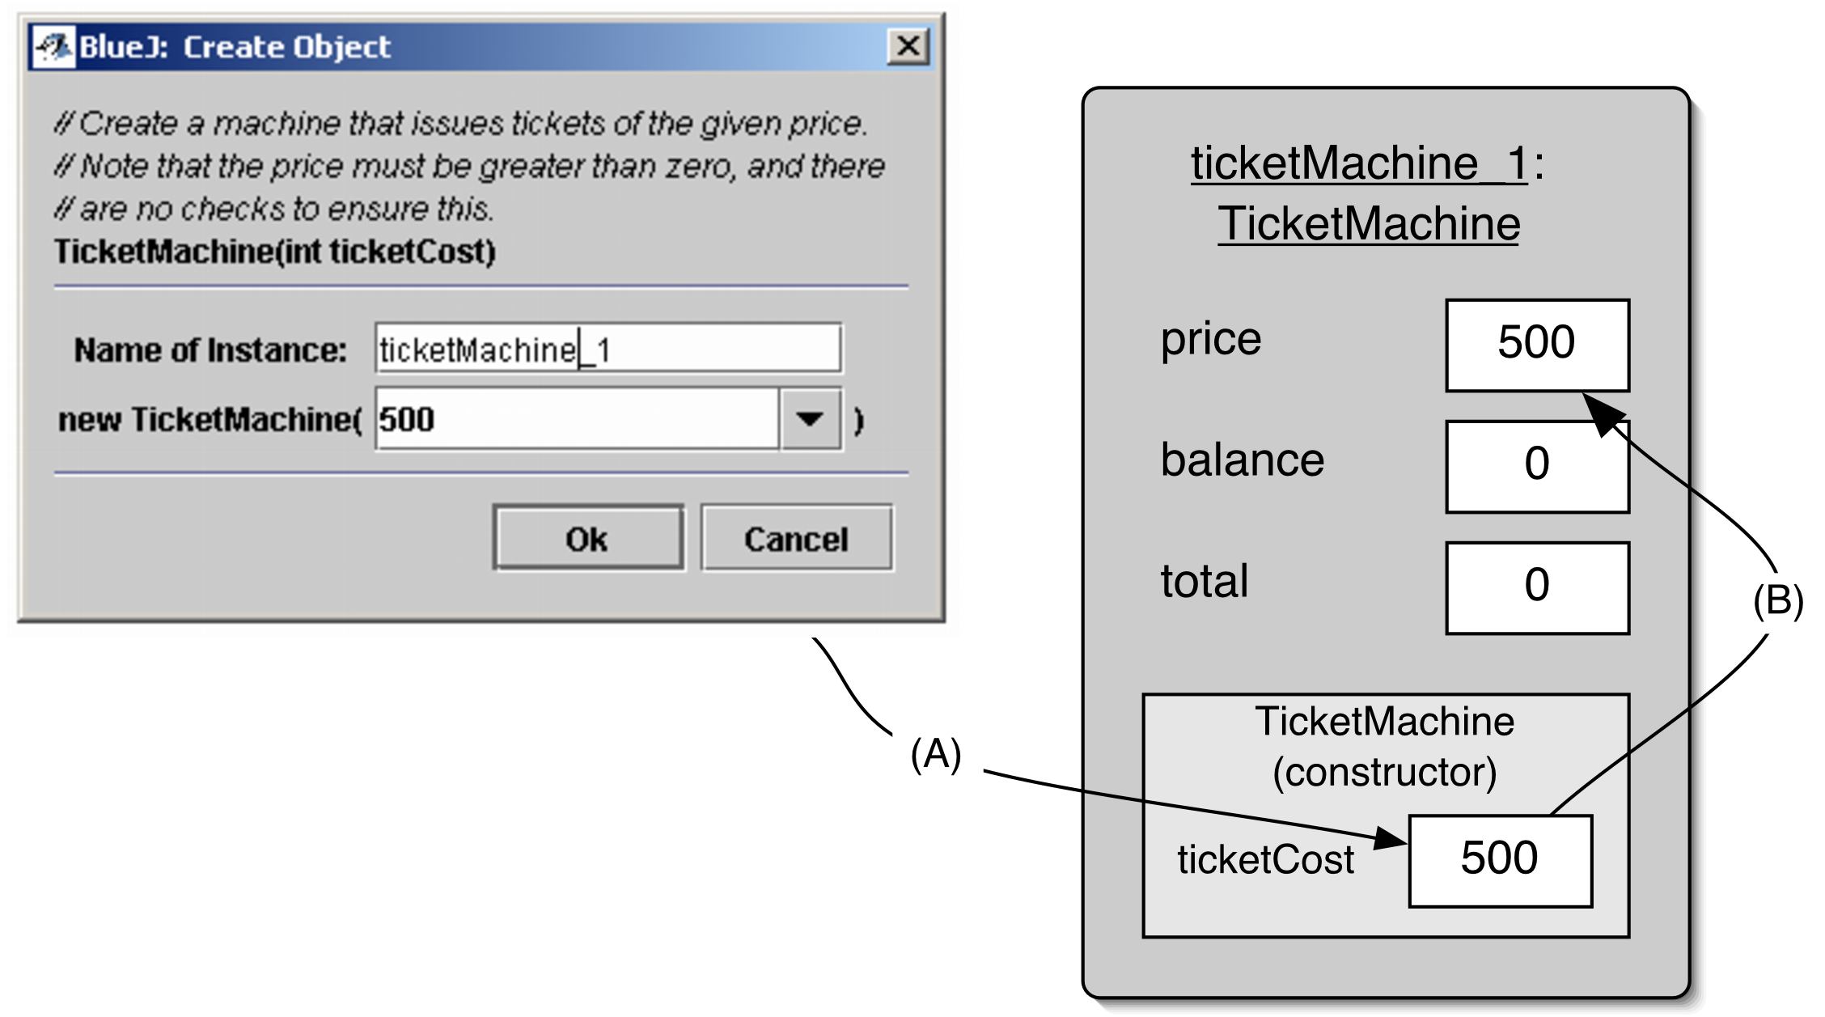
Passing data via parameters

Slide 31
Parameters
Parameter names inside a constructor or method are referred to as Formal Parameters.
Parameter values provided from the outside are referred to as Actual Parameters.
In the example: ticketCost is a formal parameter and 500 is an actual parameter.

Slide 32
Space
The ticketCost box in the object representation is only created when the constructor is executed.
Extra temporarily storage is provided to store a value for ticketCost. This is called the constructor space or method space.
Values can only be used during the execution.

Slide 33
Scope and Lifetime
The scope of a variable/parameter defines the section of the code from where it can be accessed.
For instance variables this is the entire class.
For parameters, this is the constructor or method that declares it.
Trick: find the enclosing {}, this is the scope
The lifetime of a variable/parameter describes how long the variable continues to exist before it is destroyed.

Slide 34
Assignment
Values are stored into fields (and other variables) via assignment statements:
  variable = expression;
  price = ticketCost;
Both sides of the assignment should have the same type, e.g. int, double, String, …
A variable stores a single value, so any previous value is lost.

Slide 35
Accessor methods
Methods implement the behavior of objects.
Accessors provide information about an object.
Methods have a structure consisting of a header and a body.
The header defines the method’s signature. public int getPrice()‏
The body encloses the method’s statements.

Slide 36
Accessor methods
return type
visibility modifier
method name
parameter list (empty)‏
public int getPrice()‏
{
return price;
}
return statement
start and end of method body (block)‏

Slide 37
Mutator methods
Have a similar method structure: header and body.
Used to mutate (i.e., change) an object’s state.
Achieved through changing the value of one or more fields.
  Typically contain assignment statements.
  Typically receive parameters.

Slide 38
Mutator methods
visibility modifier
return type (void)‏
method name
parameter
public void insertMoney(int amount)‏
{
balance += amount;
}
assignment statement
field being changed

Slide 39
Abstract Data Types
Classes define types
  Can be used as parameter, field and return types
The internal is hidden from the user
  No direct access to fields (unless special reason)‏
  Access to state via accessor and mutator methods
User does not need to know how the class is implemented to use/instantiate it
The usage of a class is defined by its methods

Slide 40
Printing from methods
public void printTicket()‏
{
// Simulate the printing of a ticket.
System.out.println("##################");
System.out.println("# The BlueJ Line");
System.out.println("# Ticket");
System.out.println("# " + price + " cents.");
System.out.println("##################");
System.out.println();
// Update the total collected with the balance.
total += balance;
// Clear the balance.
balance = 0;
}

Slide 41
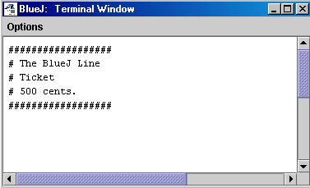
Output

Slide 42
Reflecting on the ticket machines
Their behavior is inadequate in several ways:
  No checks on the amounts entered.
  No refunds.
  No checks for a sensible initialization.
How can we do better?
  We need more sophisticated behavior.

Slide 43
Making choices
public void insertMoney(int amount)‏
{
if(amount > 0) {
balance += amount;
}
else {
System.out.println("Use a positive amount: " +
amount);
}
}

Slide 44
Making choices
boolean condition to be tested - gives a true or false result
‘if’ keyword
actions if condition is true
if(perform some test) {
Do the statements here if the test gave a true result
}
else {
Do the statements here if the test gave a false result
}
actions if condition is false
‘else’ keyword

Slide 45
Boolean Tests
== : equality
> : greater than
< : less than
<= : less or equal than
>= : greater or equal than
!= : not equal

Slide 46
Local variables
Fields are one sort of variable.
  They store values through the life of an object.
  They are accessible throughout the class.
Methods can include shorter-lived variables.
  They exist only as long as the method is being executed.
  They are only accessible from within the method.

Slide 47
Local variables
A local variable
public int refundBalance()‏
{
int amountToRefund;
amountToRefund = balance;
balance = 0;
return amountToRefund;
}
No visibility
modifier

Slide 48
Review
Class bodies contain fields, constructors and methods.
Fields store values that determine an object’s state.
Constructors initialize objects.
Methods implement the behavior of objects.
Constructors are methods which do not return anything.

Slide 49
Review
Fields, parameters and local variables are all variables.
Fields persist for the lifetime of an object.
Parameters are used to receive values into a constructor or method.
Local variables are used for short-lived temporary storage.

Slide 50
Review
Objects can make decisions via conditional (if) statements.
A true or false test allows one of two alternative courses of actions to be taken.

Slide 51
Coding Convention
If statement
  Always use { , even if there is only one statement
  In case there is an else statement, start on a new line and use {
Indentation
  Always indent your code, even if your text editor does not do it automatically
Document your code, the sooner the better.

Slide 52
Terms
Instance variables
Local variables
Parameters
Formal Parameters
Actual Parameters
Scope
Lifetime
Constructors
Methods
If-statement
Assignment
=
+=
<=, >=, <, >, !=, ==

Slide 53
Object interaction
Creating cooperating objects

Slide 54
Main concepts to be covered
Abstraction
Modularization
Class and Object Diagrams
Call-by-reference and Call-by-value
Overloading
Internal and External method calls
this keyword
Debugging

Slide 55
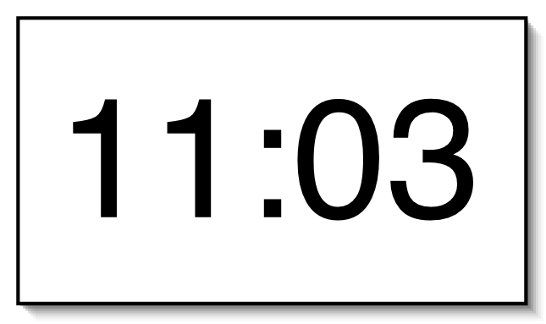
A digital clock

Slide 56
Abstraction and modularization
Abstraction is the ability to ignore details of parts to focus attention on a higher level of a problem.
Modularization is the process of dividing a whole into well-defined parts, which can be built and examined separately, and which interact in well-defined ways.

Slide 57



Modularizing the clock display
One four-digit display?
Or two two-digit displays?

Slide 58
Implementation:
NumberDisplay
public class NumberDisplay
{
private int limit;
private int value;
Constructor and
methods omitted.
}

Slide 59
Implementation
ClockDisplay
public class ClockDisplay
{
private NumberDisplay hours;
private NumberDisplay minutes;
Constructor and
methods omitted.
}

Slide 60
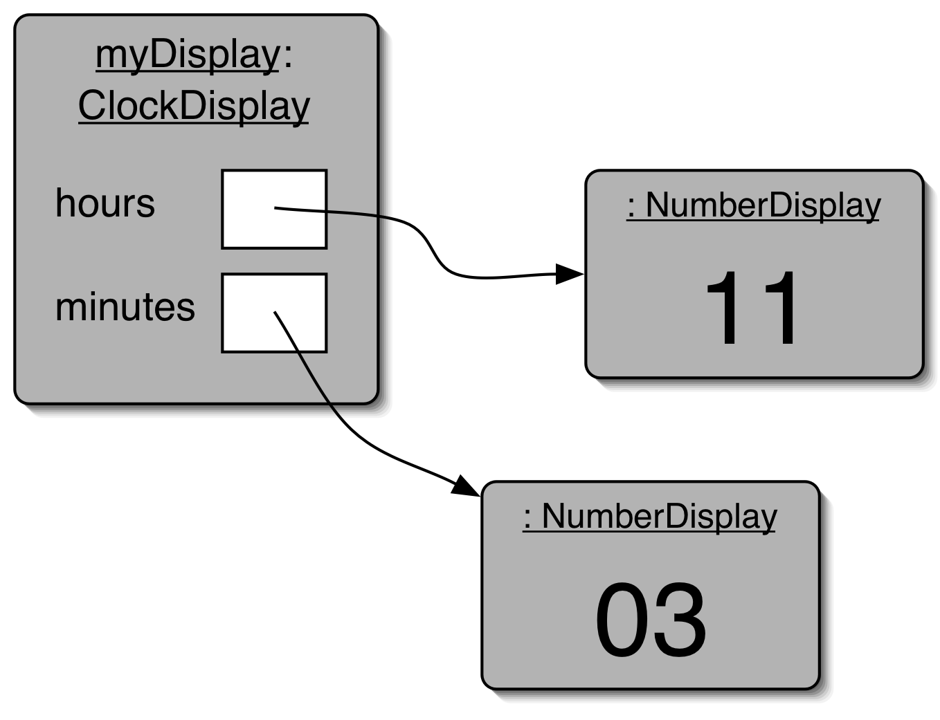
Object diagram

Slide 61
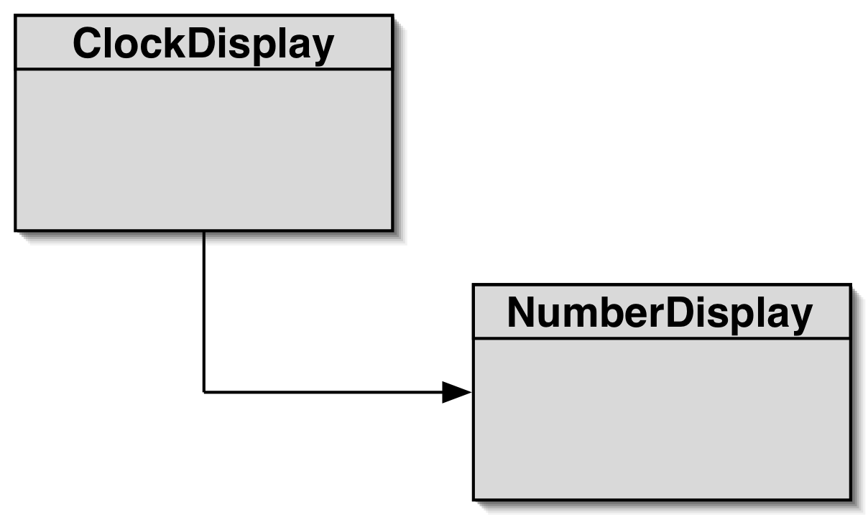
Class diagram

Slide 62
Diagrams
Class Diagrams
  Shows the classes of an application and the relationships between them
  Gives information about the source code
  Static view of the program
Object Diagrams
  Shows objects and their relationships at one moment in time during the execution of the program
  Dynamic view of the program

Slide 63
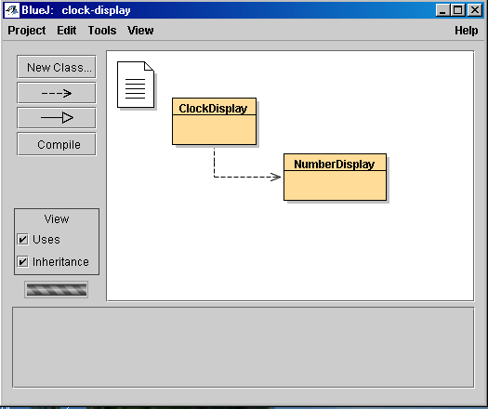
BlueJ and Diagrams

Slide 64
Primitive types vs. object types
Java defines two very different kinds of type: primitive types and object types.
Primitive types are predefined by Java.
Object types originate from classes.
Variables and parameters store references to objects.
The primitive types are non-object types.

Slide 65
Primitive types vs. object types
SomeObject obj;
object type
int i;
32
primitive type

Slide 66
Primitive types vs. object types
SomeObject a;
SomeObject b;
b = a;
int a;
int b;
32
32

Slide 67
Call-by-reference and
Call-by-value
There are two ways of passing arguments to methods in many programming languages: call-by-value and call-by-reference.
Call-by-value: A copy of the actual parameter is passed to the formal parameter of the called method. Any change made to the formal parameter will have no effect on the actual parameter.

Slide 68
Call-by-reference and
Call-by-value
Call-by-reference: the caller gives the called method the ability to directly access to the caller’s data and to modify that data if the called method so chooses.
Java uses call-by-value

Slide 69
Source code: NumberDisplay
public class NumberDisplay
{
private int limit;
private int value;
public NumberDisplay(int rollOverLimit)‏
    {
    limit = rollOverLimit;
    value = 0;
    }

Slide 70
Source code: NumberDisplay
    public int getValue()‏
    {
    return value;
    }
    public void setValue(int replacementValue)‏
    {
    if((replacementValue >= 0) &&
    (replacementValue < limit))‏
    value = replacementValue;
    }

Slide 71
Logical Operators
&& : and, operands are tested, left to right, until conclusion can be reached
|| : or, operands are tested, left to right, until conclusion can be reached
! : not
& : and, both operands are tested
| : or, both operands are tested

Slide 72
Source code: NumberDisplay
    public String getDisplayValue()‏
    {
    if(value < 10)‏
    return "0" + value;
    else
    return "" + value;
    }
    public void increment()‏
    {
    value = (value + 1) % limit;
    }
}

Slide 73
String Concatenation
Addition:
  12 + 24
String Concatenation:
  “Java” + “with BlueJ” -> “Javawith BlueJ”
  “answer: ” + 42 -> “answer: 42”

Slide 74
String toString() method
String toString() method: Java provides a way of transforming every Object into a String. To tailor this to your own preference write a method toString() returning a String representation of your class/object.
public String toString()‏
{
return “value: “ + value + “ with limit ” + limit;
}

Slide 75
The Modulo Operator
% : the modulo operator calculates the remainder of an integer division
  27 & 4 -> 3
Division in Java: if both arguments are integers, division will result in an integer.
  double res = 5 / 2 -> res = 2
  double res = 5 / (2.0) or 5 / (2 * 1.0)
      -> res = 2.5

Slide 76
Objects creating objects
public class ClockDisplay
{
private NumberDisplay hours;
private NumberDisplay minutes;
private String displayString;
public ClockDisplay()‏
{
hours = new NumberDisplay(24);
minutes = new NumberDisplay(60);
updateDisplay();
}
}

Slide 77
Objects creating objects
new ClassName(parameter-list)‏
  It creates a new object of the named class
    here NumberDisplay
    this involves creating sufficient memory to store the values of primitive instance variables and references to object instance variables.
It executes the constructor of that class
public NumberDisplay
new NumberDisplay
formal parameter
(int rollOverLimit)‏
actual parameter
(24)‏

Slide 78
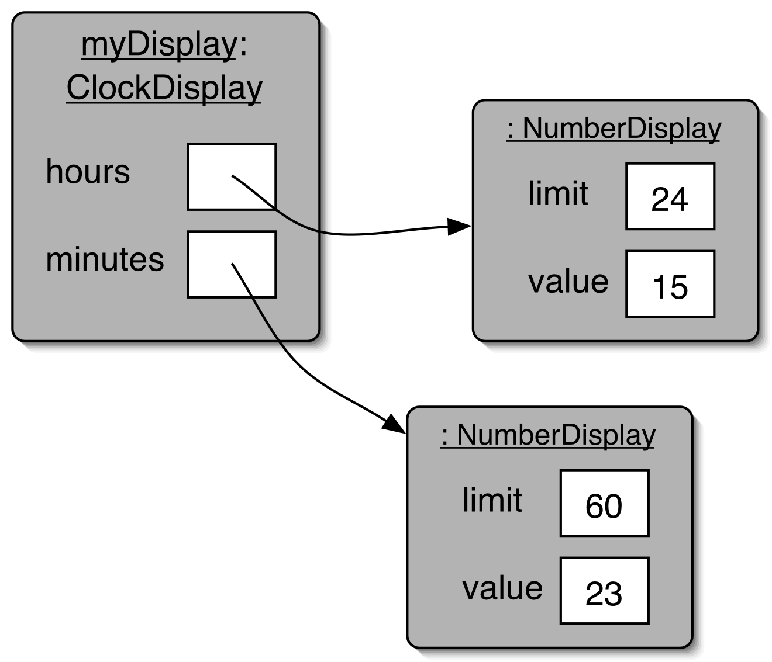
ClockDisplay object diagram

Slide 79
Method Overloading
Multiple Constructors of ClockDisplay:
  new Clockdisplay()‏
  new Clockdisplay(hour, minute)‏
It is common for class definitions to contain alternative versions of constuctors or methods that provide various ways of achieving a particular task via their distinctive sets of parameters.
This is known as overloading.

Slide 80
Method calling
public void timeTick()‏
{
minutes.increment();
if(minutes.getValue() == 0) {
// it just rolled over!
hours.increment();
}
updateDisplay();
}

Slide 81
Internal method
/**
* Update the internal string that
* represents the display.
*/
private void updateDisplay()‏
{
displayString =
hours.getDisplayValue() + ":" +
minutes.getDisplayValue();
}

Slide 82
Method calls
internal method calls
updateDisplay();
private void updateDisplay()‏
    methodName(parameter-list)
external method calls
minutes.increment();
    object.methodName(parameter-list)‏

Slide 83
Public and Private Methods
Public methods:
    public void increment()‏
    can be called externally
Private methods
    private void updateDisplay()‏
    can only be called internally
    used for auxiliary methods

Slide 84
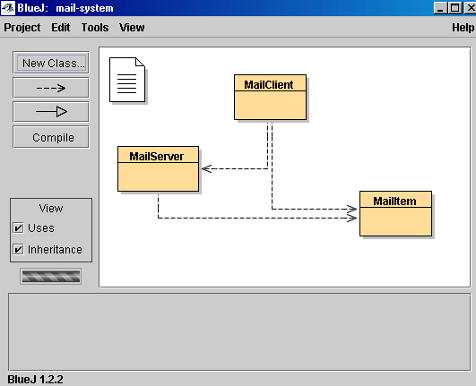
The Mail System

Slide 85
The this Keyword
public class MailItem
{
private String from;
private String to;
private String message;
public MailItem(String from, String to,
String message)‏
{
this.from = from;
this.to = to;
this.message = message;
}

Slide 86
The this Keyword
this.from = from
  name overloading: the same name is used for two different entities: instance variable and formal parameter.
  this is used to go out of the scope of the constructor to class level
  this always refers to the current object.
  can also used for methods
  for internal methods calls and access to instance fields Java automatically inserts this
  updateDisplay -> this.updateDisplay

Slide 87
Concepts
abstraction
modularisation
call-by-value
call-by-reference
logical operators/modulo
this
class/object diagram
primitive types
object types
object creation
overloading
internal/external method calls
private methods
debugging

